Slide 1
Statistics: A Tool For Social Research
Eleventh Edition
Joseph F. Healey

Slide 2
Estimation Procedures
Chapter 7

Slide 3
Learning Objectives
Explain the logic of estimation and the role of the sample, sampling distribution, and the population.
Define and explain the concepts of bias and efficiency.
Construct and interpret confidence intervals for sample means and sample proportions.
Explain the relationships among confidence level, sample size, and the width of the confidence interval.
Use SPSS to get sample statistics to use in the construction of confidence intervals.

Slide 4
Chapter Outline
Estimation Selection Criteria: Bias and Efficiency
Interval Estimation Procedures
Interval Estimation Procedures for Sample Means (Large Samples)
Interval Estimation Procedures for Sample Proportions (Large Samples)
Computing Confidence Intervals: A Summary
Controlling the Width of Interval Estimates
Interpreting Statistics: Predicting Election Outcomes and Judging the Performance of the President

Slide 5
In This Presentation
The logic of estimation and key terms
How to construct and interpret interval estimates for:
  Sample means
  Sample proportions
Choosing which formula to use
Controlling the width of confidence intervals

Slide 6
Basic Logic
In estimation procedures, statistics calculated from random samples are used to estimate the value of population parameters
Example:
  If we know 42% of a random sample drawn from a city are Republicans, we can estimate the percentage of all city residents who are Republicans

Slide 7
Two Estimation Procedures (1 of 2)
A point estimate is a sample statistic used to estimate a population value
  A newspaper story reports that 74% of a sample of randomly selected Americans support capital punishment

Slide 8
Two Estimation Procedures (2 of 2)
An interval estimate: Confidence intervals consist of a range of values
“Between 71% and 77% of Americans approve of capital punishment”
Most point estimates in media are actually interval estimates
“Margin of error” = intervals

Slide 9
Bias and Efficiency
Criteria for choosing estimators:
Bias: An estimator is unbiased if the mean of its sampling distribution is equal to the population value of interest
Sample means and proportions are unbiased estimators
Efficiency: The extent to which the sampling distribution is clustered around its mean
Larger samples have greater clustering around mean and are thus more efficient

Slide 10
Interval Estimation Procedures (1 of 20)
Set the alpha (α), probability that the interval will be wrong
Find the Z score associated with alpha using Appendix A
Substitute values into appropriate equation
Interpret the interval
Additional consideration: If the Z score you are seeking is between two other scores, choose the larger of the two Z scores

Slide 11
Interval Estimation Procedures (2 of 20)
Finding Z
Setting alpha equal to 0.05 produces a 95% confidence level and means the researcher is willing to be wrong 5% of the time
If alpha is equal to 0.05, we would place half (0.025) of this probability in the lower tail and half in the upper tail of the distribution
Looking up this area in column c of Appendix A, we find a Z of 1.96

Slide 12
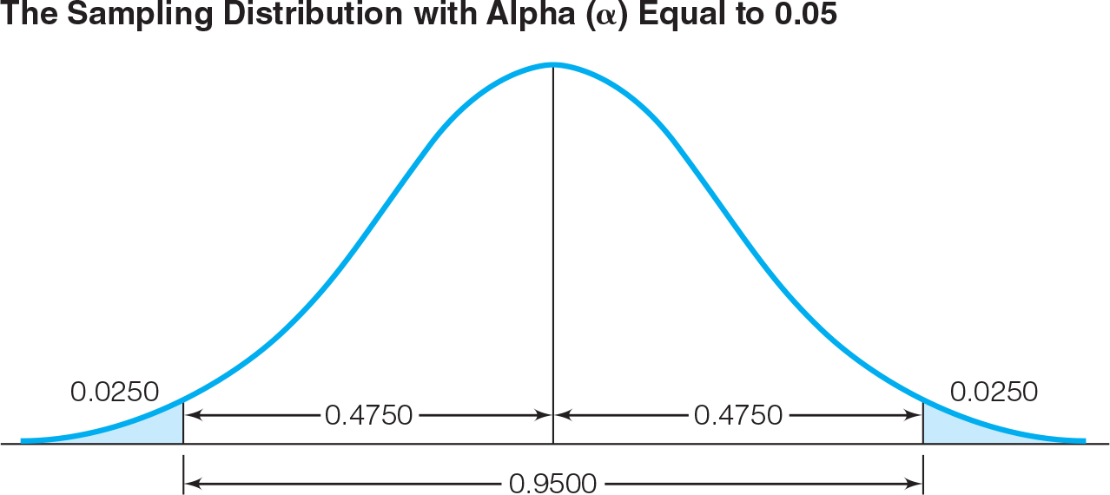
Interval Estimation Procedures (3 of 20)
Finding Z

Slide 13
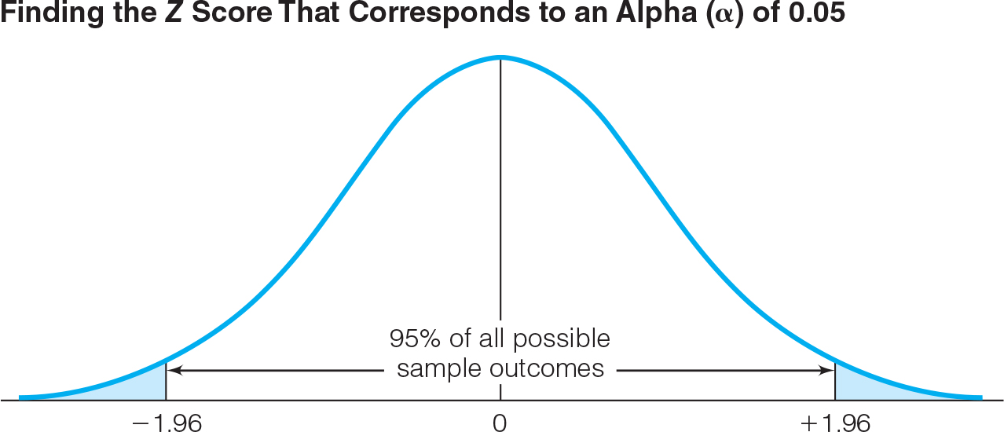
Interval Estimation Procedures (4 of 20)

Slide 14
Interval Estimation Procedures (5 of 20)
Finding Z for Common Confidence Levels
Z Scores for Various Levels of Alpha (α)
Confidence Level | Alpha (α) | α/2 | Z Score
90% | 0.10 | 0.05 | ±1.65
95% | 0.05 | 0.025 | ±1.96
99% | 0.01 | 0.005 | ±2.58
99.9% | 0.001 | 0.0005 | ±3.32
99.99% | 0.0001 | 0.00005 | ±3.90

Slide 15
Interval Estimation Procedures (6 of 20)
Finding Z
Set the confidence level to 85%
Given that the confidence level is 85%, we are willing to be wrong 15% of the time, and alpha equals 0.15
Dividing the total area of 0.15 across the two tails of the sampling distribution, we find an area in one tail of 0.0750 (0.15/2)
Looking in column c of Appendix A, we find a Z of 1.44 for an area of 0.749 and a Z of 1.43 for an area of 0.0764
Choosing between these two Z scores, we would pick 1.44, the larger of the two

Slide 16
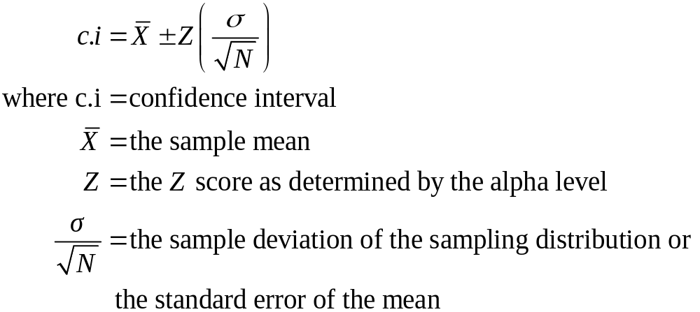
Interval Estimation Procedures (7 of 20)
Confidence Intervals for Sample Means
Large (N≥100) Samples, σ Known

Slide 17
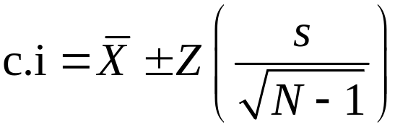
Interval Estimation Procedures (8 of 20)
Confidence Intervals for Sample Means
Large (N≥100) Samples, σ Unknown
In the case of small (N<100) samples, use the Student’s t distribution covered in Chapter 8

Slide 18
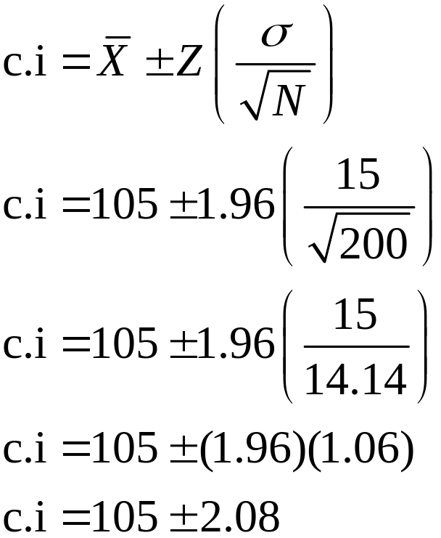
Interval Estimation Procedures (9 of 20)
Example 1: Large Sample, σ Known
  From a sample of 200 residents the sample mean IQ is 105 and the population standard deviation is 15
  Calculate a 95% (alpha = 0.05) confidence interval

Slide 19
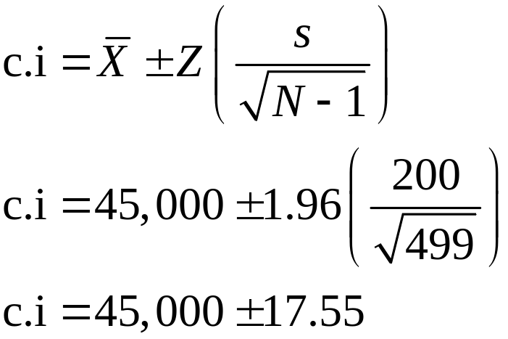
Interval Estimation Procedures (10 of 20)
Example 2: Large Sample, σ Unknown
  The mean income for a random sample of 500 community residents is $45,000 with a standard deviation of $200
  Calculate a 95% (alpha = 0.05) confidence interval

Slide 20
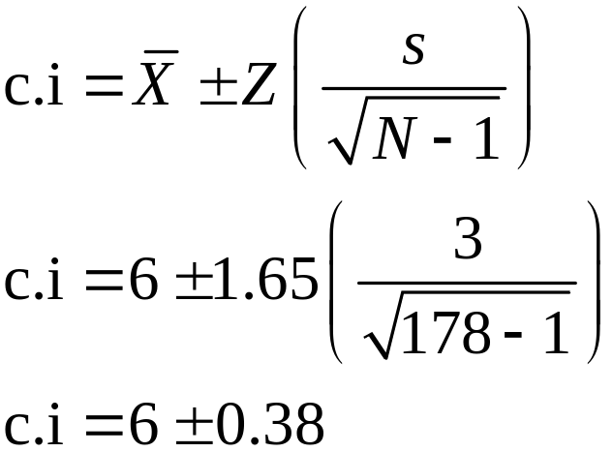
Interval Estimation Procedures (11 of 20)
Example 3: Problem 7.5c (p. 181)
  For a random sample of 178 households, average TV viewing was 6 hours a day with a standard deviation of 3
  Calculate a 90% (alpha = 0.10) confidence interval

Slide 21
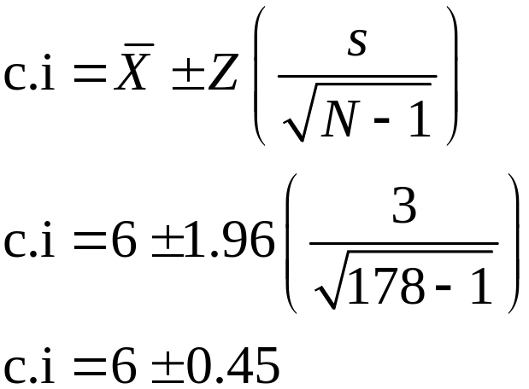
Interval Estimation Procedures (12 of 20)
Example 3: Problem 7.5c (p. 177)
  For a random sample of 178 households, average TV viewing was 6 hours a day with a standard deviation of 3
  Calculate a 95% (alpha = 0.05) confidence interval

Slide 22
Interval Estimation Procedures (13 of 20)
For 95% level, we can estimate that households in this community average 6 ± 0.45 hours of TV watching each day
Another way to state the interval:
  5.56 ≤ μ ≤ 6.45
  We estimate that the population mean is greater than or equal to 5.56 and less than or equal to 6.45
This interval has a .05 chance of being wrong

Slide 23
Interval Estimation Procedures (14 of 20)
Final Points
Even if the statistic is as much as ±1.96 standard deviations from the mean of the sampling distribution the confidence interval will still include the value of μ
Only rarely (5 times out of 100) will the interval not include μ

Slide 24
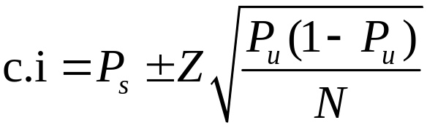
Interval Estimation Procedures (15 of 20)
Confidence Intervals for Sample Proportions
Calculation Steps:
  Set the alpha level
  Find the Z score associated with alpha using Appendix A
  Substitute values into formula

Slide 25
Interval Estimation Procedures (16 of 20)
Confidence Intervals for Sample Proportions
Note that the formula for the standard error includes the population value we do not currently know and are trying to estimate (P_{u})
By convention we set P_{u} equal to 0.50 so that the numerator value [P_{u}(1-P_{u})] is at its maximum value
  P_{u}(1-P_{u}) = (0.50)(1-0.50) = 0.25
The calculated interval will be at its maximum width
This is considered the most statistically conservative technique

Slide 26
Interval Estimation Procedures (17 of 20)
Example 1: Confidence Intervals for Sample Proportions
We wish to estimate the proportion of students at your university who missed at least one day of classes because of illness last semester
In a random sample of 200 students, 60 students reported missing one day of class due to illness
Thus, the sample proportion is 0.30 (60/200)
Calculate a 95% (alpha = 0.05) confidence interval

Slide 27
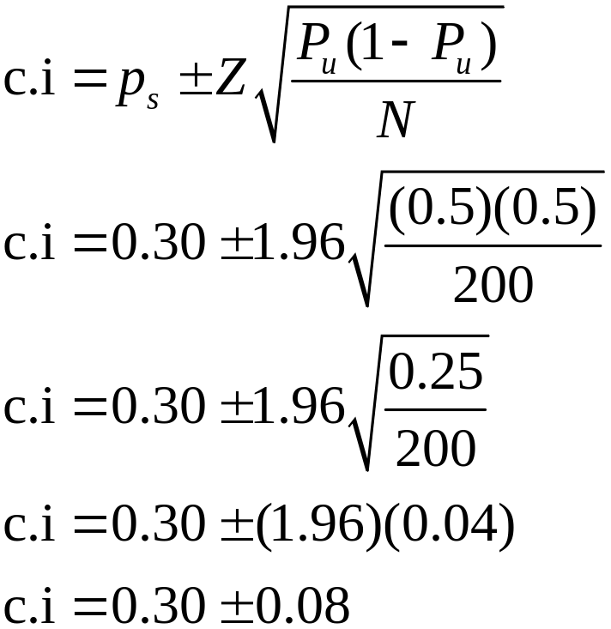
Interval Estimation Procedures (18 of 20)
Example 1: Confidence Intervals for Sample Proportions

Slide 28
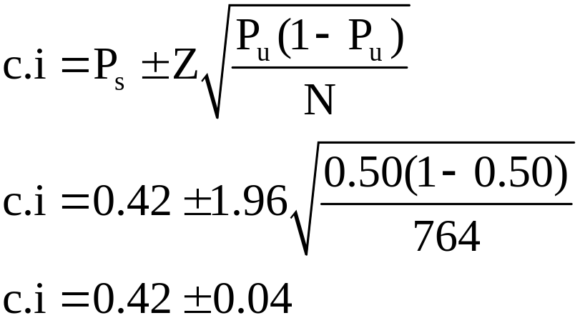
Interval Estimation Procedures (19 of 20)
Example 2: Confidence Intervals for Sample Proportions
If 42% of a random sample of 764 from a Midwestern city are Republicans, what percentage of the entire city are Republicans?
Calculate a 95% (alpha = 0.05) confidence interval

Slide 29
Interval Estimation Procedures (20 of 20)
Example 2: Confidence Intervals for Sample Proportions
Changing back to percentages, we can estimate that 42% ± 4% of city residents are Republicans
Another way to state the interval:
  38% ≤ P_{u} ≤ 46%
  We estimate the population value is greater than or equal to 38% and less than or equal to 46%
This interval has a .05 chance of being wrong

Slide 30
Interpretations (1 of 2)
Interpret a confidence interval in a sentence or two that includes information on:
The sample statistic (mean or proportion)
The calculated confidence interval
The sample size (N)
The population to which you are estimating
The confidence level (often 95%)

Slide 31
Interpretations (2 of 2)
Examples:
c.i. = 45,000 ± 17.55 = $44,982.45 to $45,017.55
  “Based on a sample of 200 community residents, we are 95% confident that the estimated average income for the entire community is between $44,982.45 and $45,017.55”
c.i. = 0.30 ± 0.08 = 0.22 to 0.38
  “Based on a sample of 200 college students, we are 95% confident that the estimated proportion of students that had missed one day of class due to illness last year is between 0.22 and 0.38, or between 22% and 38%

Slide 32

Width of Interval Estimates (1 of 2)
The width of confidence intervals can be controlled by manipulating two terms in the equation:
The confidence level (or alpha)
  When the confidence level increases (and the alpha decreases) the calculated interval is wider
Confidence Intervals Grow Wider as Confidence Levels Increase (
= $45,000, s = $200, N = 500 throughout)
Alpha (α) | Confidence Level | Interval | Interval Width
0.10 | 90% | $45,000 ± 14.77 | $29.54
0.05 | 95% | $45,000 ± 17.54 | $35.08
0.01 | 99% | $45,000 ± 23.09 | $46.18
0.001 | 99.9% | $45,000 ± 29.71 | $59.42

Slide 33




Width of Interval Estimates (2 of 2)
The width of confidence intervals can be controlled by manipulating two terms in the equation:
The sample size
  When sample size increases the calculated interval is narrower
= $45,000, s = $200, α = 0.05 throughout)
Confidence Intervals Grow Narrower as Sample Size Increases(
N | Confidence Interval | Interval Width
100 | c.i. = $45,000 ± 1.96 = $45,000 ± $39.40 | $78.80
500 | c.i. = $45,000 ± 1.96 = $45,000 ± $17.54 | $35.08
1,000 | c.i. = $45,000 ± 1.96 = $45,000 ± $12.40 | $24.80
10,000 | c.i. = $45,000 ± 1.96 = $45,000 ± $3.92 | $ 7.84

Slide 34
Interpreting Statistics: Predicting Election Outcomes
Pollsters are very accurate in predicting the outcomes of presidential elections.
The predictions differ because pollsters use different sampling techniques and different definitions of “likely voters.”
Polls and Actual Results, Presidential Race, 2016
Polls* | N | Margin of Error | Predicted for Clinton | Predicted for Trump
Bloomberg | 799 | ±3.5 | 46% | 43%
IBD/TIPP Tracking | 1107 | ±3.1 | 43% | 42%
LA Times/USC Tracking | 3935 | ±4.5 | 44% | 47%
ABC/Wash Post Tracking | 2220 | ±2.5 | 49% | 46%
FOX News | 1295 | ±2.5 | 48% | 44%
 | ACTUAL VOTE |  | 48% | 46%

Slide 35



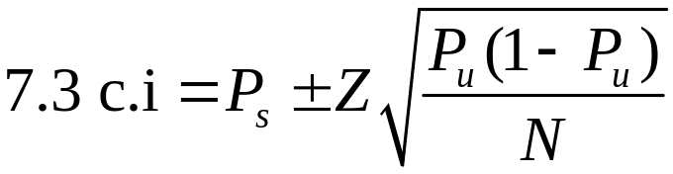
Summary
Choosing Formulas for Confidence Intervals
If the sample statistic is a | And the population standard deviation (s) is | Use Formula
Mean | Known
Mean | Unknown
Proportion (P_{s})

